Slide 1
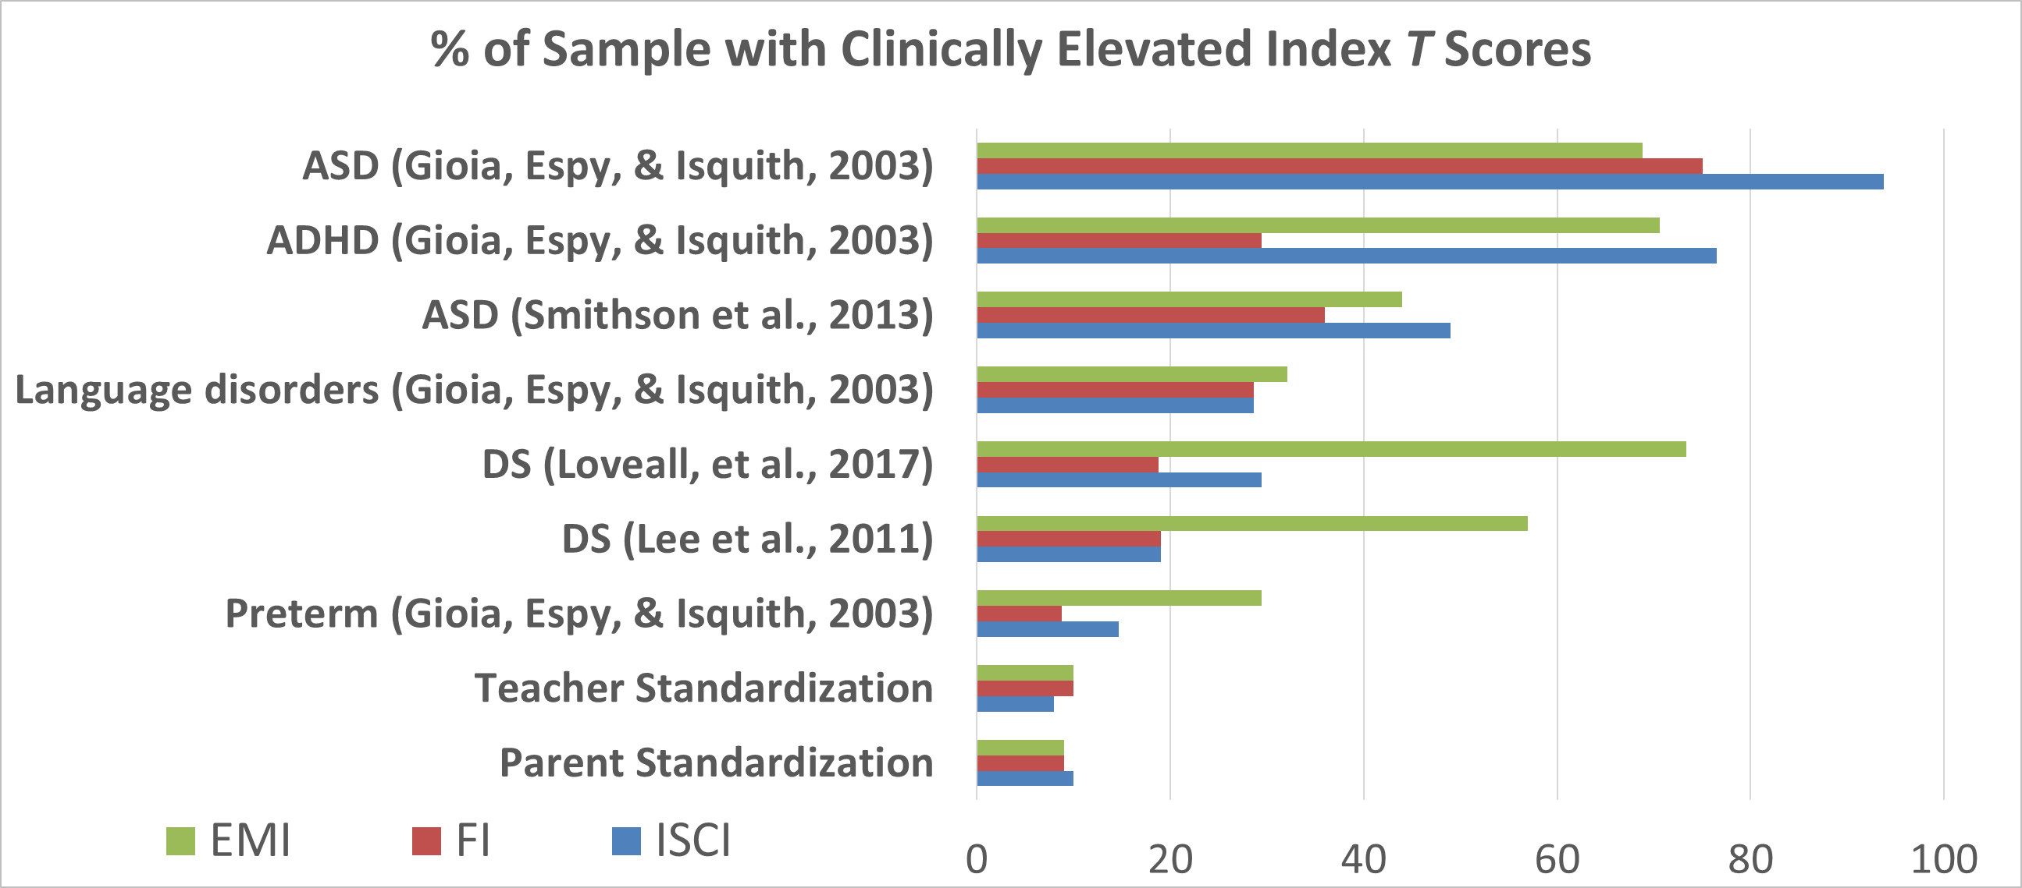
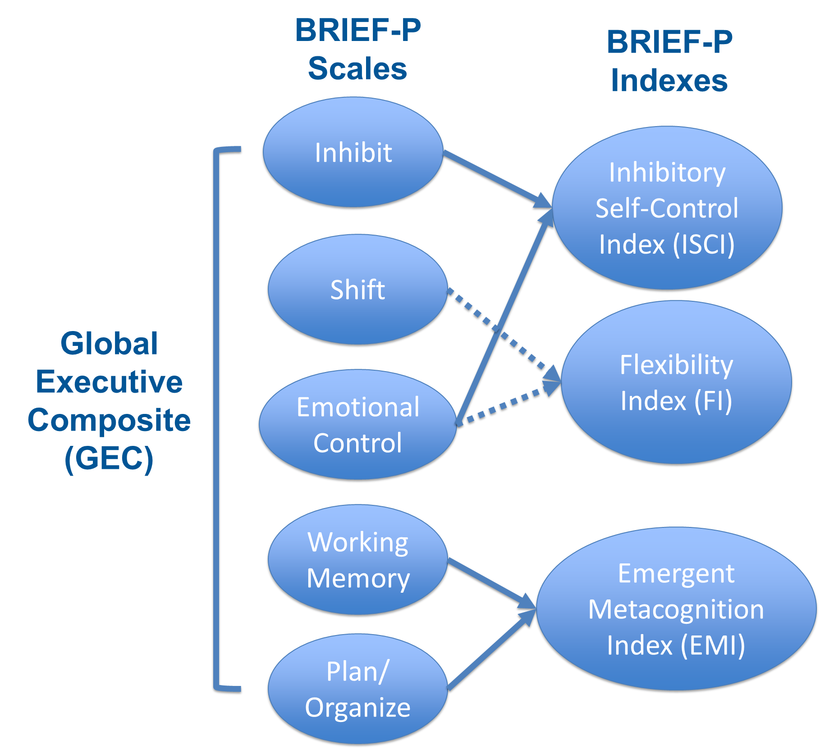
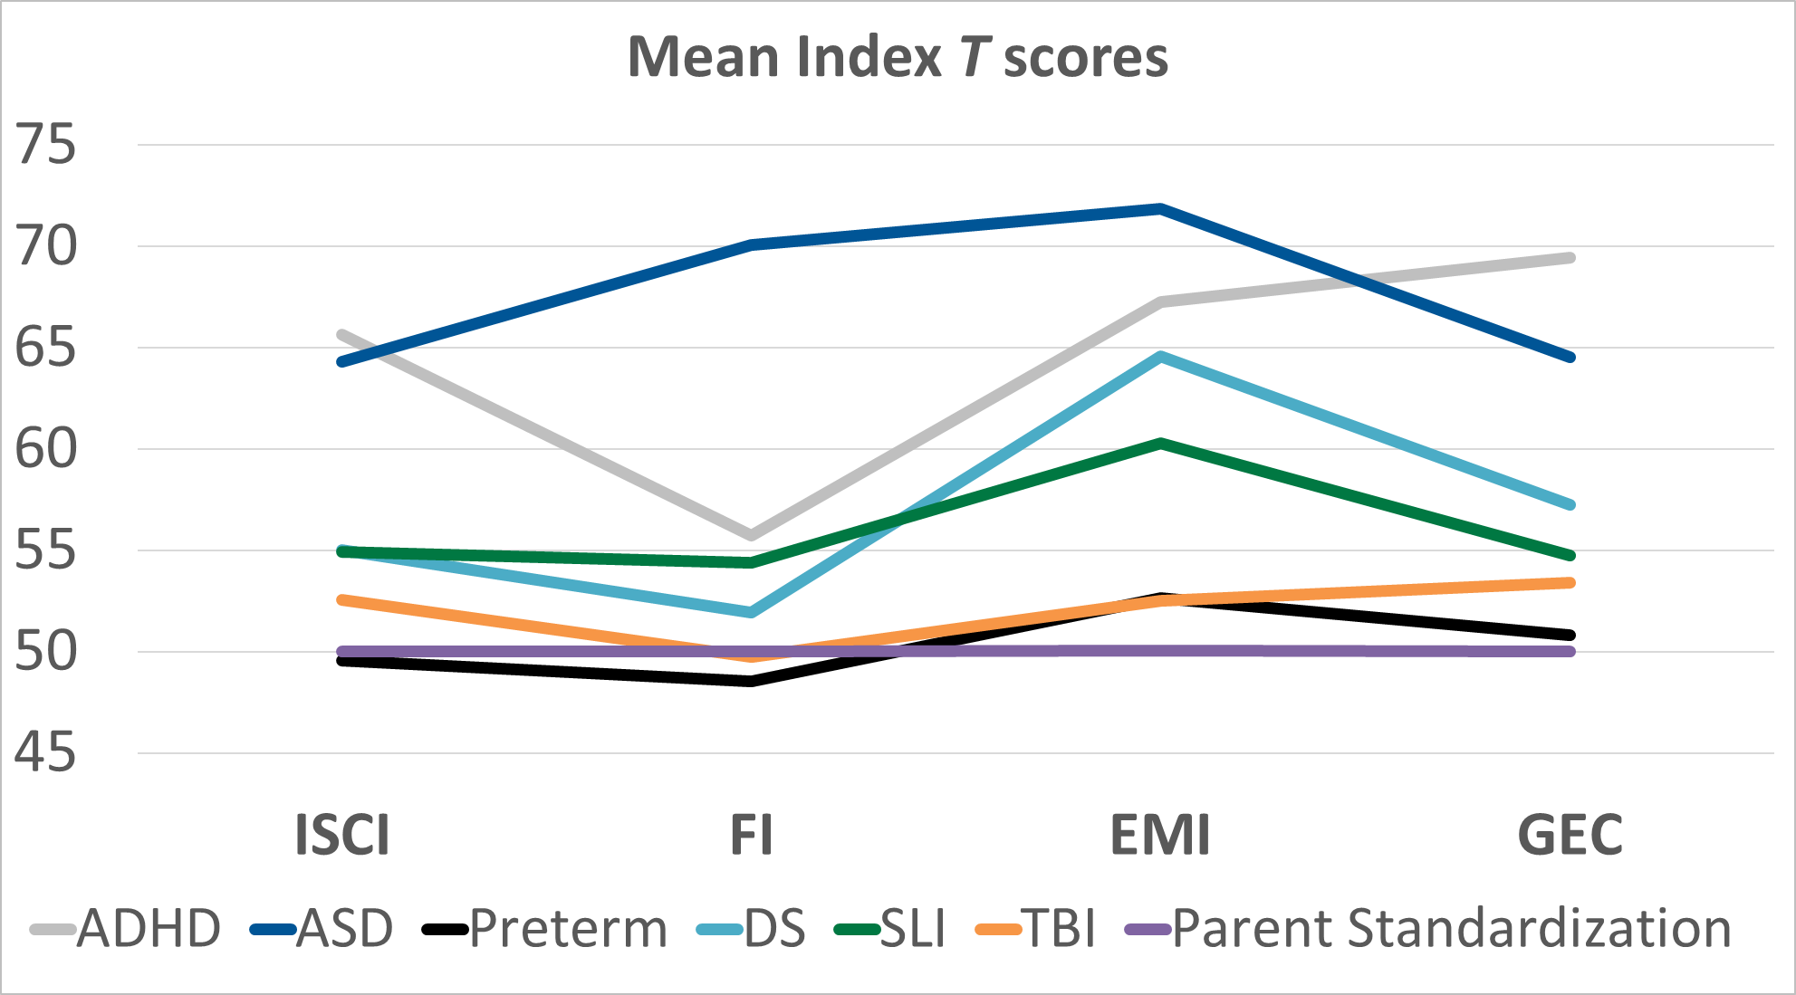
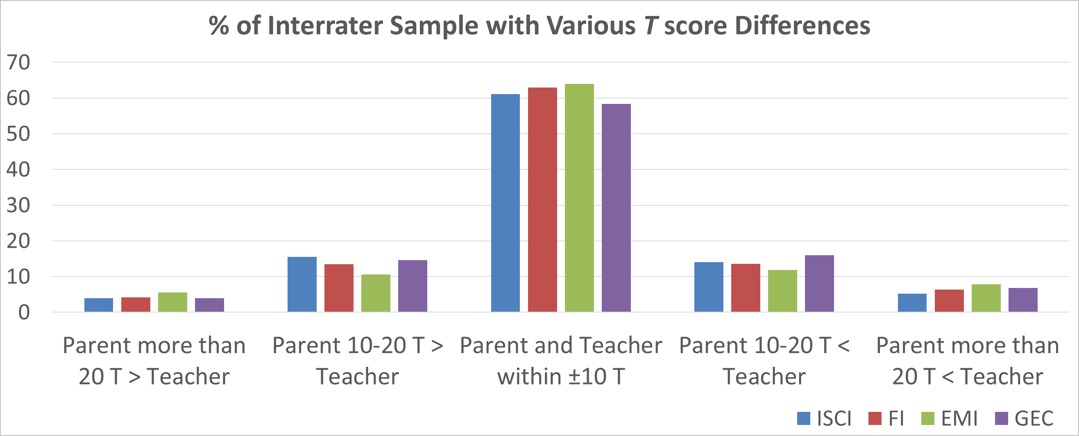
Base Rates, Profile Analysis, and Interrater Discrepancies for the BRIEF-P
Jennifer A. Greene, PhD, Melissa A. Messer, MHS, & Sue M. Trujillo, MS
Background
Results
The Behavior Rating Inventory of Executive Function–Preschool Version (BRIEF-P; Gioia, Espy, & Isquith, 2003) is a rating scale for parents and teachers of preschool-aged children that assesses everyday behaviors associated with executive functions in the home and school environments.
Contains 5 scales that combine to form three indexes and one summary score.
Base rates
Parents and teachers rated 9-11% of typically developing children as having an elevated GEC (T score ≥ 65). This compares to 71% of children with ADHD, 51-81% of children with ASD, 27-42% of children with a TBI, and 42-53% of children with DS.
Within the indexes, 69-77% of children with ASD were elevated on all the indexes, 71% of children with ADHD were elevated on the EMI and 77% were elevated on the ISCI. 57-73% of children with DS were elevated on the EMI.
Inhibit | Controls impulses and behavior; appropriately stops and modulates own behavior at the proper time or in the proper context
Shift | Moves freely from one situation, activity, or aspect of a problem to another as the situation demands; makes transitions; solves problems flexibly
Emotional Control | Modulates emotional responses appropriately to situational demand or context
Working Memory | Holds information in mind for the purpose of completing a task or making the appropriate response; stays with, or sticks to, an activity
Plan/ Organize | Anticipates future events or consequences; uses goals or instructions to guide behavior in context; develops or implements appropriate steps ahead of time to carry out an associated task or action
Clinical profiles
Index T scores across studies of the same clinical group were averaged and are plotted below.
Children with ASD were most elevated on the FI and the EMI. Children with ADHD were most elevated on the ISCI and the EMI. Children with DS and SLI were most elevated on the EMI.
Note. ADHD = attention-deficit hyperactivity disorder; ASD = autism spectrum disorder; DS = Down syndrome; SLI = speech/language impairment, TBI = traumatic brain injury
Interrater differences
The correlations between parent and teacher BRIEF-P index scores ranged from .11 to .26. The mean differences between scores were very small, with effect sizes ranging from 0.05 to 0.10, indicating overall agreement between raters.
Approximately 58-64% of parents and teachers reported scores within 10 T-score points, with only 9-15% being discrepant by more than 20 T-score points.
Objective: Parent and teacher interrater ratings on the BRIEF-P were analyzed, along with additional clinical data collected since the publication of the BRIEF-P, to provide additional statistical evidence to support score interpretation.
Methods
Methods:
Base rates and profiles of elevated T scores were examined for the BRIEF-P standardization samples and the various clinical samples.
Interrater differences: Correlations, mean differences and effect sizes for each index were examined. Base rates of various T-score differences for each index were calculated.
Conclusions
Participants:
BRIEF-P parent (N = 460) and teacher (N = 302) standardization samples.
BRIEF-P parent/teacher interrater sample (N = 302).
Various clinical groups from 35 studies using the BRIEF-P.
Examining base rates of elevated scores highlights how often similar scores occur in typically developing children versus children with clinical conditions. Similarly, scores within a profile can be compared to profiles in known clinical groups.
Percentages of T score differences derived from the interrater sample can be reviewed to determine how frequently differences occur between raters. Uncommon differences should be investigated to determine why they exist.

