Slide 1
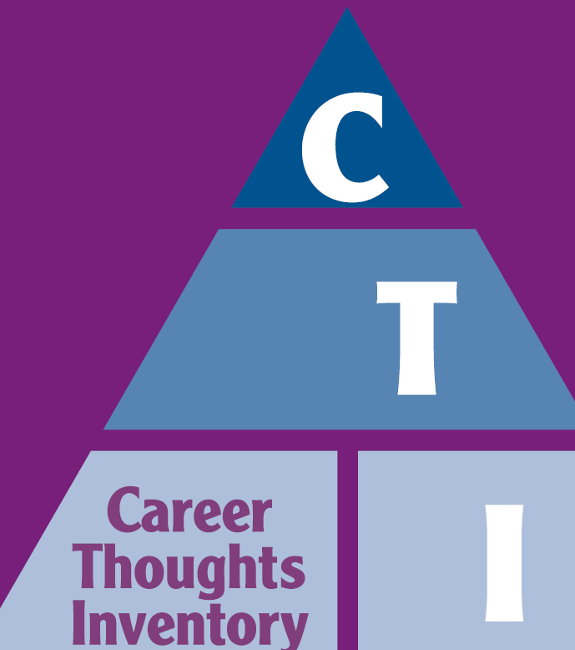
The Relationship between RIASEC Personality Types and Negative Thinking: Implications for Career Counseling
Jennifer Greene, MSPH
Psychological Assessment Resources, Inc.

Slide 2
My Background
Masters of Science in Public Health
Doctoral student: PhD in Measurement at the University of South Florida
Research and Development Team at Psychological Assessment Resources (PAR)
Develop assessments for a wide variety of needs
Career Development
Also, achievement, intelligence, personality, mood, neuropsychology, speech/language, etc.

Slide 3
Introductions
Your background
What made you want to come to this presentation?

Slide 4
Agenda
Research Objective
Hypotheses
Measures Used
Method
Participants
Results/Discussion
Case Study

Slide 5
Objective
To explore the relationship between RIASEC types (as measured by the Self-Directed Search) and negative career thoughts (as measured by the Career Thoughts Inventory)

Slide 6
Hypotheses
Hypothesis 1: Low scores on the SDS secondary constructs (congruence, consistency, coherence, differentiation, and profile elevation) are related to higher endorsement of negative career thoughts.
Hypothesis 2: Social and Enterprising types are less likely to endorse negative career thinking, and R and C types are more likely to do so.

Slide 7
Measures
Self-Directed Search, Fifth Edition
(SDS; Holland & Messer, 2013)
Career Thoughts Inventory
(CTI; Sampson, Peterson, Lenz,
Reardon, & Saunders)
Notes:
Ask about familiarity, focus on what they need to learn

Slide 8
Self-Directed Search (SDS)
The SDS (Holland & Messer, 2013) is a self-administered career counseling tool.
It is divided into four sections: activities, competencies, occupations, and self-estimates.
The top three scores across all sections represent an individual’s Summary Code, the three personality types they most resemble.

Slide 9
Notes:
The SDS measures the degree to which a person resembles each of the personality types. The three letter summary code indicates which three personality types a person most resembles,
And by using 3 letters it conveys the complexity of that individual’s personality.
Handout

Slide 10
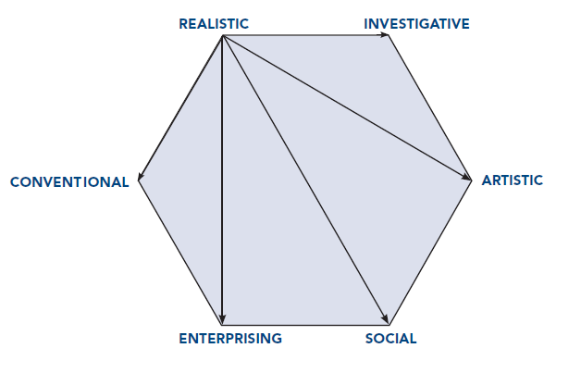
Hexagonal Model
Notes:
The degree of congruence (or agreement) between a person and an occupation (environment) can be estimated by a hexagonal model. The
shorter the distance between the personality type and the occupational type, the closer the relationship. For example, an R-person and an R-occupation are the most
congruent. An R-person and an S-occupation are the incongruent.

Slide 11
Secondary Constructs Related to Similarity
SDS Construct | Definition | Calculation
Congruence | Degree of fit between a Summary Code and code of current job aspirations | Iachan Agreement Index (Iachan, 1984a), ranges from 0 to 28, with higher scores indicating more agreement between the two codes.
Consistency | Similarity of position of first two code letters on the hexagon | High: first two letters of the code are adjacent on the RIASEC hexagon , such as R and C, assigned a score of 3 Average: first two letters are alternate (i.e., neither adjacent nor opposite), such as I and S, assigned a score of 2 Low: first two letters are opposite, such as C and A, assigned a score of 1
Coherence | Degree of similarity between the first letters of the individual’s first three listed occupational aspirations | High: first three occupational aspirations have the same first letter, assigned a score of 3 Average: first letter of the first aspiration is also the first letter in the second or third aspiration, assigned a score of 2 Low: first letter of the first aspiration is not the first letter of the second or third aspiration, assigned a score of 1

Slide 12
Secondary Constructs Related to the RIASEC Profile
SDS Construct | Definition | Calculation
Differentiation | Shape of the profile of summary scores, i.e., flat or spiked | Iachan Differentiation Index (Iachan, 1984b), ranges from 0 to 20, with higher scores indicating more differentiation.
Profile Elevation | Overall level of endorsement of items across all domains of the SDS | Summing the total number of items endorsed across all RIASEC scales, ranges from 12 to 336, with higher scores indicating higher endorsement across all RIASEC domains.

Slide 13
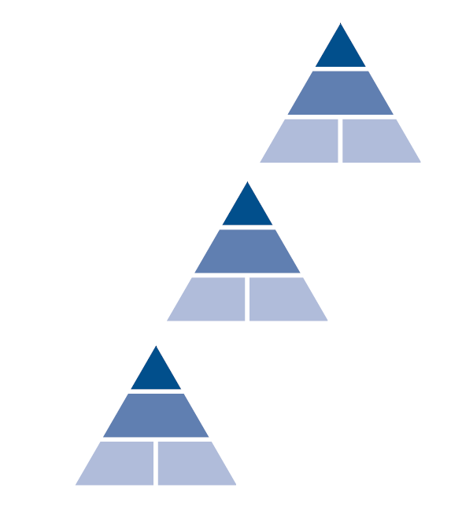
Career Thoughts Inventory (CTI)
The CTI is a theory-based assessment and intervention resource intended to improve the quality of career services offered.
Cognitive information processing (CIP) theoretical approach to career development and career services (Peterson, et al., 1991; Peterson, et al., 1996)
Cognitive therapy theoretical approach to mental health and mental health services (Beck, 1976).
10-15 minutes to complete
Higher scores indicate higher levels of the scale’s measured construct.

Slide 14
CTI Scales
The CTI yields a CTI Total score (a single global indicator of dysfunctional thinking in career problem solving and decision making) as well as scores on three construct scales:
Decision Making Confusion (14 items)
This scale reflects an inability to initiate or sustain the decision making process as a result of disabling emotions and/or a lack of understanding about the decision making process itself.
Commitment Anxiety (10 items)
This scale reflects an inability to make a commitment to a specific career choice, accompanied by generalized anxiety about the outcome of the decision making process, with the anxiety perpetuating the indecision.
External Conflict (5 items)
This scale reflects an inability to balance the importance of one’s own self-perceptions with the importance of input from significant others, resulting in a reluctance to assume responsibility for decision making.

Slide 15
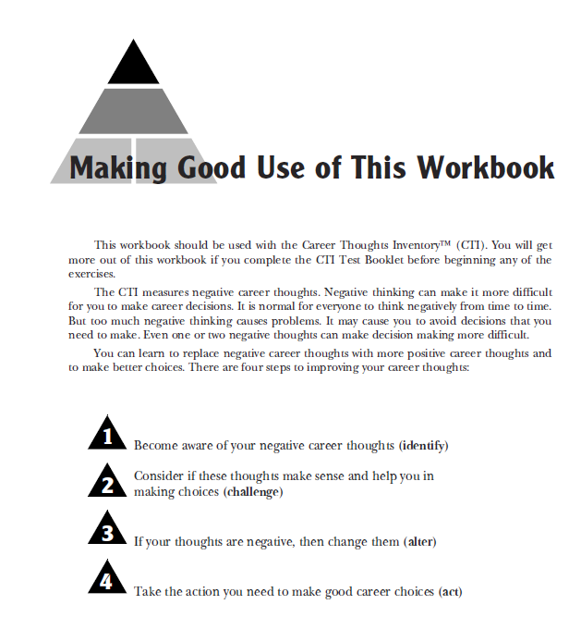
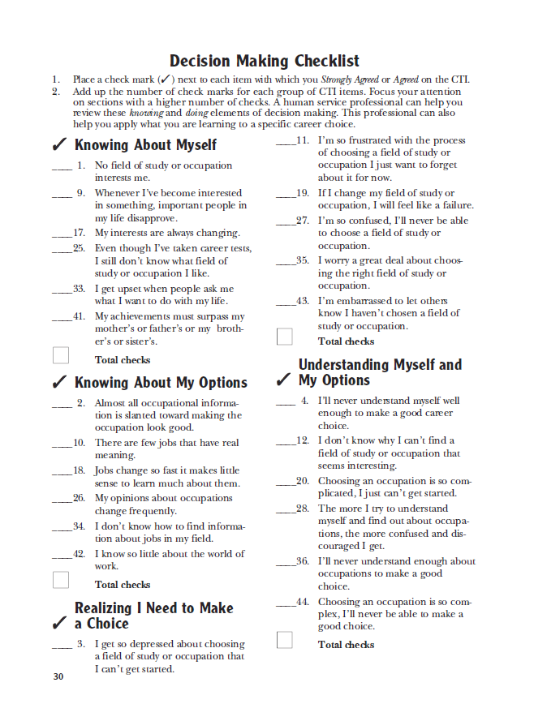
CTI Workbook

Slide 16
Background
Previous studies (Chason, Bullock-Yowell, Sampson, Lenz, Reardon, 2013; Wright, Reardon, Peterson, & Osborn, 2000) have focused on the relationship between secondary constructs of the Self-Directed Search, Fourth Edition and negative career thoughts as measured by the Career Thoughts Inventory (Sampson, Peterson, Lenz, Reardon & Saunders, 1996).
In order to further elucidate the relationship between SDS constructs and negative career thoughts, the current study aims to examine the secondary constructs with the newest edition of the SDS

Slide 17
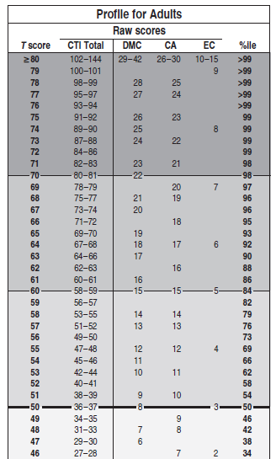
Method
Participants were divided into two groups based on their CTI total T-score.
Independent samples t-tests on mean endorsement of each RIASEC type and mean congruence, consistency, coherence, differentiation and profile elevation.
Effect size, Cohen’s d, was calculated
.20 = small
.50 = medium
.80 or higher = large
Elevated
Non-Elevated

Slide 18
Participants
A subsample of the SDS Standardization sample (n = 51)
Both groups were similar in terms of gender, age and racial/ethnic breakdown
Characteristic | N (%) or M (SD)
 | Overall | Elevated | Non-Elevated
n | 51 | 22 | 29
Gender
Male | 26 (51.0) | 11 (50) | 15 (51.7)
Female | 25 (49.0) | 11 (50) | 14 (48.3)
Age (years)
M | 34.24 | 36.82 | 32.28
SD | 17.04 | 19.87 | 14.60
Range | 11-69 | 15-69 | 11-69
Race/ethnicity
Caucasian | 22 (43.1) | 10 (45.5) | 12 (41.4)
African American | 8 (15.7) | 2 (9.1) | 6 (20.7)
Hispanic | 19 (37.3) | 9 (40.9) | 10 (34.5)
Other | 2 (3.9) | 1 (4.5) | 1 (3.4)

Slide 19
Hypothesis 1: Supported
The elevated group had lower means on all secondary constructs except for differentiation
Congruence, coherence and profile elevation had largest differences
medium effect sizes (d=.50, .57, .44, respectively).
T-tests = ns, but the trend of the differences were in the right direction
Construct | Elevated |  | Non-Elevated |  | M difference | Effect size
 | M | SD | M | SD
Congruence | 14.41 | 8.13 | 18.48 | 8.42 | -4.07 | .50
Consistency | 2.18 | .73 | 2.34 | .67 | -0.16 | .24
Coherence | 1.65 | .70 | 2.05 | .74 | -0.40 | .57
Differentiation | 6.28 | 3.57 | 5.84 | 3.38 | 0.45 | .13
Profile Elevation | 131.86 | 33.21 | 149.34 | 45.49 | -17.48 | .44

Slide 20
Hypothesis 2: Supported
The elevated group had higher means of endorsement of the Realistic and Conventional types than the non-elevated group.
The elevated group had lower means of endorsement of the Social and Enterprising types than the non-elevated group.
The groups were significantly different on Conventional
 | Elevated |  | Non-Elevated |  | Mean difference | Effect size
SDS Code Type | M | SD | M | SD
Realistic | 18.32 | 14.96 | 16.83 | 12.40 | 1.49 | .11
Investigative | 16.64 | 10.76 | 18.48 | 11.54 | -1.84 | .17
Artistic | 17.55 | 13.61 | 16.17 | 11.18 | 1.38 | .11
Social | 23.14 | 12.13 | 23.93 | 12.89 | -0.79 | .06
Enterprising | 21.73 | 8.37 | 23.66 | 11.25 | -1.93 | .19
Conventional | 24.09 | 7.90 | 18.10 | 11.69 | 5.99 | .60*

Slide 21
Discussion
Realistic and Conventional types, as well as those with low scores on the secondary constructs of the SDS, may be more prone to negative career thoughts and may need additional career or personal counseling during the career development process.

Slide 22
Case Study: Bruce
college sophomore trying to decide on a major
takes the SDS at his university’s career center
Given his SDS results the fact that Bruce is a Realistic type, he may be prone to negative career thinking
His career counselor decides to have Bruce take the CTI as well, to assess his readiness to decide on a major.
SDS Results
Summary Code | RSA (Realistic, Social, Artistic)
Consistency | Low
Differentiation | Low
Profile Elevation | Average
CTI Results
Scale | Score | %ile
CTI Total Score | 66 | 95th
Decision-Making Confusion (DMC) | 58 | 79th
Commitment Anxiety (CA) | 75 | 99th
External Conflict (EC) | 62 | 88th

Slide 23
Case Study: Bruce
During their next meeting, Bruce confirms the CTI findings and tells his career counselor he is experiencing anxiety across several life domains.
Bruce’s career counselor suggests that he seek personal counseling to help alleviate his anxiety, in addition to working with his career counselor to pick a major.
SDS Results
Summary Code | RSA (Realistic, Social, Artistic)
Consistency | Low
Differentiation | Low
Profile Elevation | Average
CTI Results
Scale | Score | %ile
CTI Total Score | 66 | 95th
Decision-Making Confusion (DMC) | 58 | 79th
Commitment Anxiety (CA) | 75 | 99th
External Conflict (EC) | 62 | 88th

Slide 24
Questions?

