Slide 1
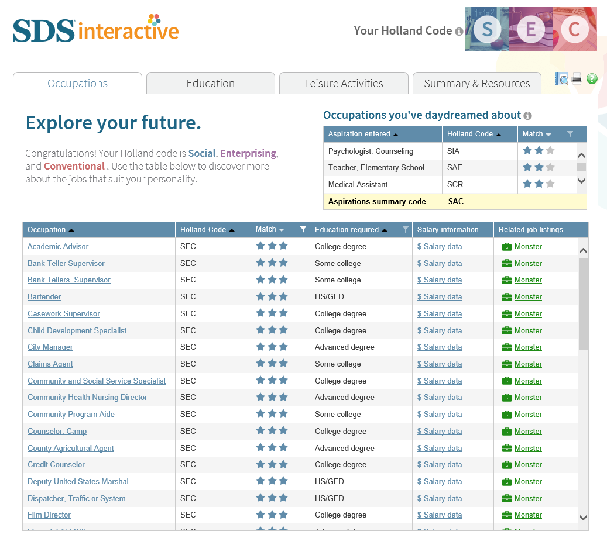
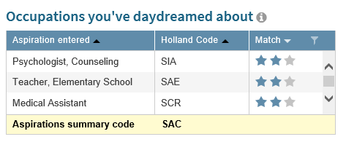
Development of an Interactive Career Counseling Tool Using the Self-Directed Search (SDS)
Jennifer A. Greene, MSPH, Psychological Assessment Resources, Inc.
Introduction
Results
John Holland’s RIASEC theory of workplace personality has featured prominently in the field of career counseling over the past 60 years.
This theory posits that most people and occupations resemble a combination of six personality types (Realistic, Investigative, Artistic, Social, Enterprising, Conventional).
From his theory, Holland developed the Self-Directed Search (SDS; Holland & Messer, 2013), a self-administered career counseling tool.
The SDS provides the user with a Summary Code, i.e., the three personality types to which they are most similar.
The SDS currently provides the client with a printable report which includes occupations, fields of study, and leisure activities which fit one’s personality type, as well as resources and next steps for career planning.
This poster describes the development of SDS Interactive, a new, interactive, Web-based version of the SDS Client Report.
Clients will now be able to utilize both the interactive report upon completion of the SDS, as well as print the text report for future reference.
Development of SDS Interactive
Most of the participants (61%) were job seekers or students directed to the SDS by their school, counselor or parent/guardian.
A majority of participants (60%) found the printable report only somewhat useful.
A conceptual new report was shown to the participants including the four tabs: Occupations, Education, Leisure Activities, Summary & Resources
Each tab has a “Match” that indicates how well the listing matches the
client’s SDS code, for example 2 out of 3 stars.
Categories like “Education Required” and “Match” can be filtered to only how the ranges of interest (for example, jobs that require more than a high school education, jobs that are a 3 out of 3 stars match).
Occupations Tab Lists careers based on the client’s code, a comparison between how well your client’s dream jobs match their SDS code, and links to monster.com jobs in your client’s area
Education Tab
Lists fields of study based on your client’s code, with links to
information about related occupations from O*NET
Leisure Activities Tab
Lists leisure activities based on your client’s code
Summary & Resources Tab
Provides next steps and resources for career planning
When comparing the current report to the conceptual new report, a majority report the new report is a significant improvement compared to only 3% who much prefer the current report.
The most useful addition of the new report is salary range, followed by the star match rating of how well each job matches the user profile.
Revisions to the conceptual design were undertaken based on this feedback.
Feedback on SDS Interactive
Many (59%) were satisfied or extremely satisfied with the SDS Interactive experience
When comparing SDS Interactive to the text report, 18% preferred “the interactive version as its more useful,” 64% felt both versions were equally helpful and 18% preferred the “text report as it is more useful.”
Most participants (75%) would recommend it to a friend or colleague.
Method
SDS Interactive was developed based on feedback from a survey of current SDS users (N = 124).
Participants reviewed the current report and were asked:
How useful was the Self Directed Search (SDS) report content?
Which section of the report was the most useful?
Next, participants were presented with a conceptual image of a new type of report and were asked:
How much of an improvement is this conceptual report versus the current SDS report you received?
What feature of the conceptual report is most helpful?
How interested would you be in purchasing the SDS with the new conceptual report?
SDS Interactive went live in May 2015. Following its release, it was evaluated with another survey of current SDS users (N = 22) in terms of how useful they found it and how satisfied they were with the experience.
Discussion
SDS Interactive is a new way to engage your clients in the career counseling process by providing them with an interactive, visually appealing, online experience.
The text report is also available to keep for future reference. Clients can use the version(s) that best meet their needs

