Slide 1
Develop your
Students’ Passion for
Career Exploration: The
Presented by:
Jennifer Greene, PhD, & Melissa Messer, MHS
NCDA 2019

Slide 2

Agenda
Career exploration
National Career Development Guidelines (NCDG)
Student Self-Directed Search (SDS)
Case study: Rex
How the StudentSDS maps onto the NCDG

Slide 3
Career exploration
Career exploration programs and activities help middle and high school students learn to explore the world of work and make choices that affect their education and future occupations.
To guide the development and implementation of such programs, NCDA devised the National Career Development Guidelines (NCDG) framework.

Slide 4
NCDG guidelines
Personal Social Development
Educational Achievement and Lifelong Learning
Career Management
Identify goals and activities that support career development throughout the lifespan within three domains.
These include knowledge and skills students need to manage their careers effectively, beginning with career exploration and making decisions about education.
This presentation will illustrate how the StudentSDS can help your students gain mastery in these domains while exploring potential careers.

Slide 5
Notes:
Also available:
StandardSDS: For adults making career and educational decisions
VeteranSDS: For military personnel transitioning to the civilian workforce

Slide 6
Student Self-Directed Search
The StudentSDS is a career assessment and exploration tool designed and tailored specifically to middle school, junior high, and high school students.
It was developed by John Holland and is based on his RIASEC person-environment typology:
Realistic
Investigative
Artistic
Social
Enterprising
Conventional

Slide 7
Student Self-Directed Search
The StudentSDS asks students about their occupational daydreams, activities, competencies, interest in a variety of occupations, and self-estimates.
The activity is structured around questions such as:
  What do you want to be when you grow up?
  Tell me about the things you like to do.
  What things can you do well?
  What occupations do or do not appeal to you?
  How would you rate your abilities and skills compared to others your age?

Slide 8
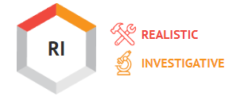





Self-Directed Search
The top two scores across all StudentSDS sections represent a student’s Summary Code and indicate the two personality types they resemble most.
This score provides a link between the student’s personality and occupations and programs of study, which are also described by a code, called a Holland code.

Slide 9
Components of the

Slide 10




Printed materials
Assessment Booklet
Career Finder
Each career is linked to a Holland code, education level, and career cluster
Icons indicate Rapid Growth and New and Emerging occupations
Educational Opportunities
Finder
Each program is linked to a Holland code and an overarching category
You and
Your Future
Workbook
Includes reflective activities and exercises to engage students in the career exploration process
Notes:
Contains printed materials as well as an individualized online report
First, we will give an overview of each printed piece, followed by an introduction to the online report, which will be highlighted more in the case study

Slide 11
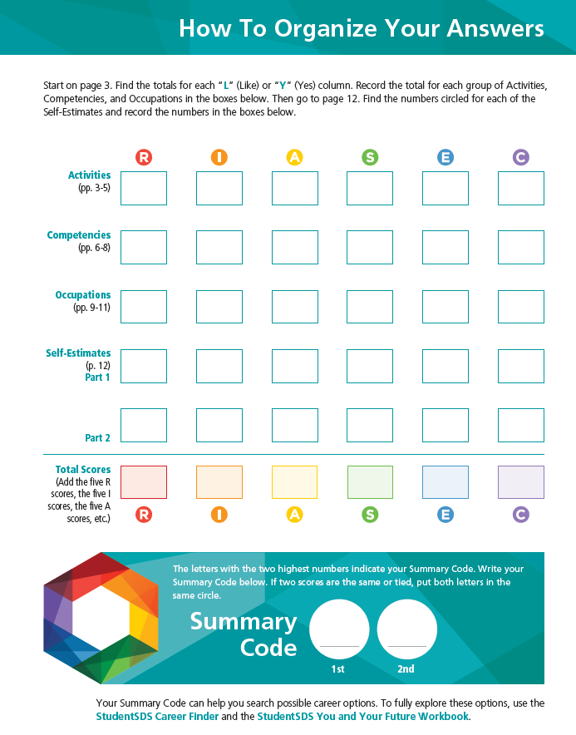
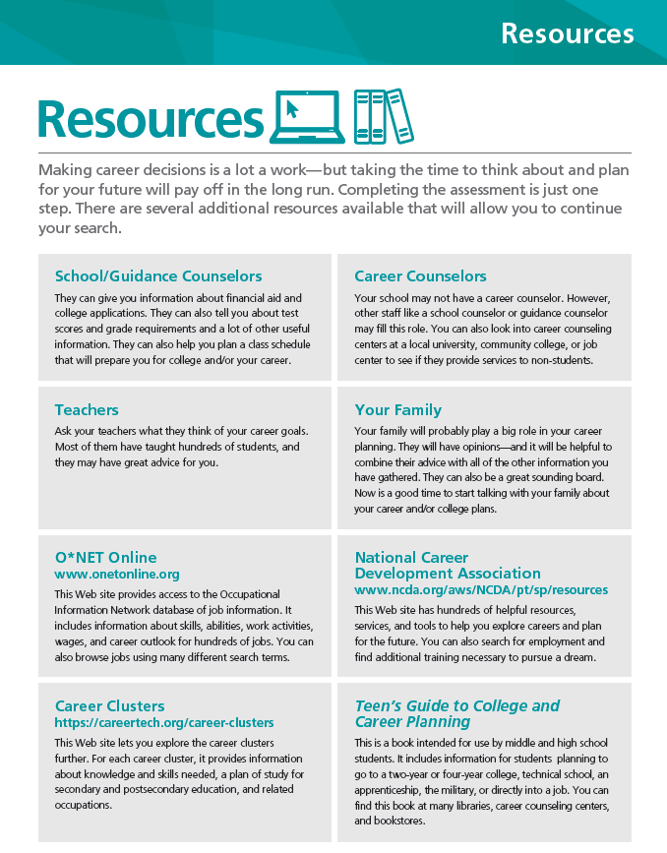
Assessment Booklet

Slide 12
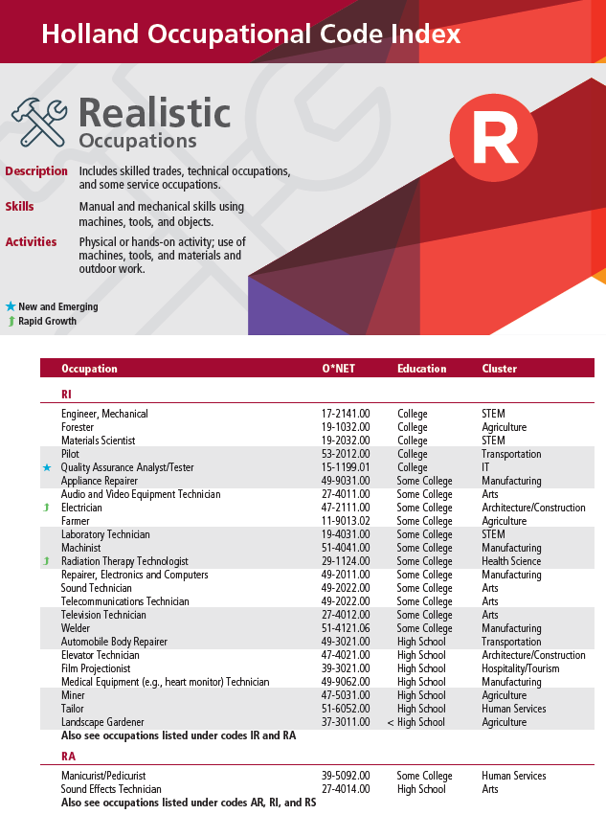
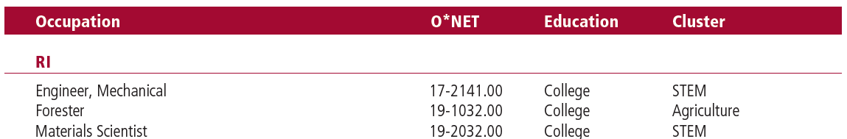
Career Finder
Notes:
Each occupation now includes ONET code and career cluster. Icons indicate if the job is New and Emerging or Rapid Growth.

Slide 13
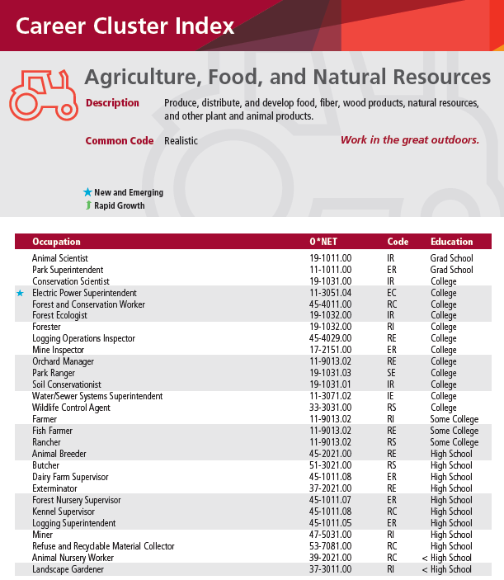
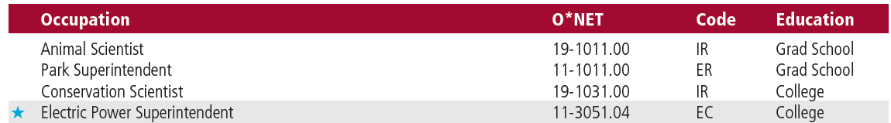
Career Finder

Slide 14
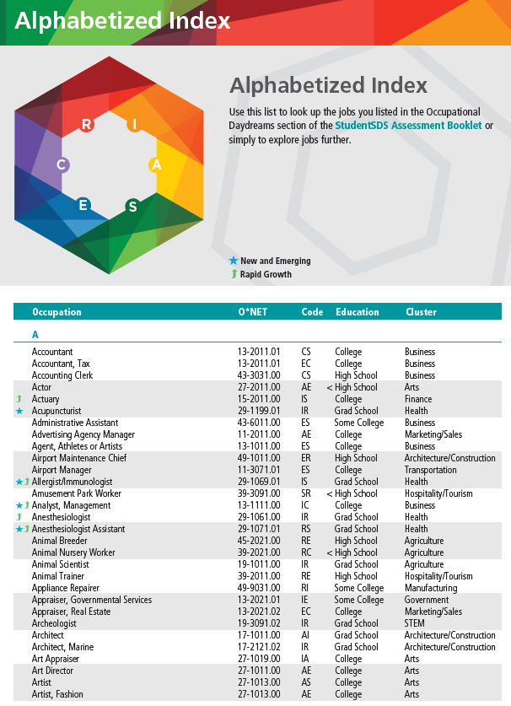
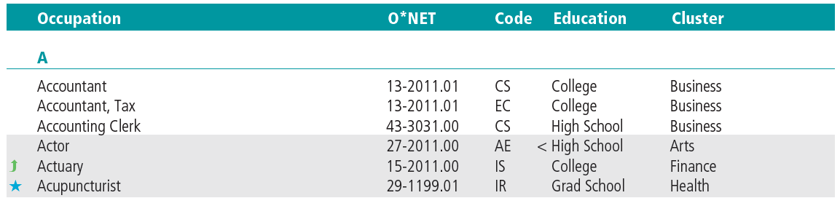
Career Finder

Slide 15
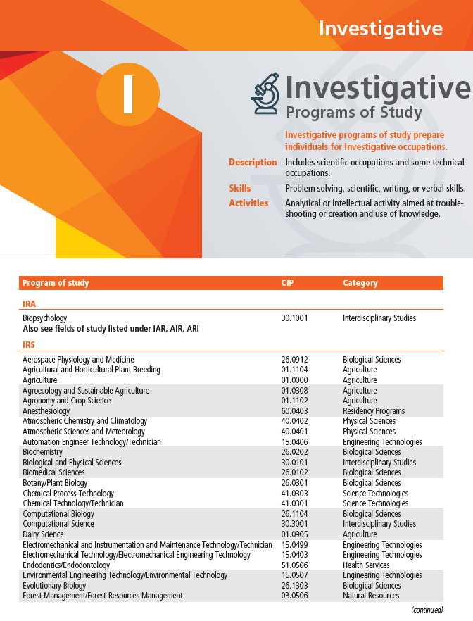
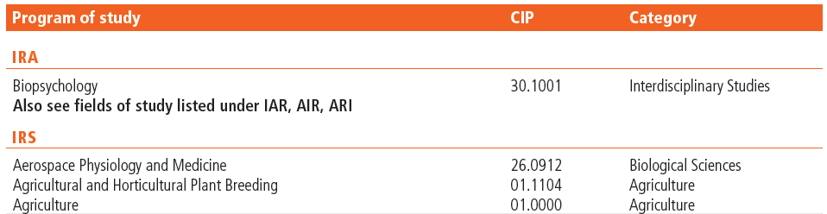
Educational Opportunities Finder
Notes:
Classification of Instructional Programs (CIP) code (first two digits for each category) and categories

Slide 16
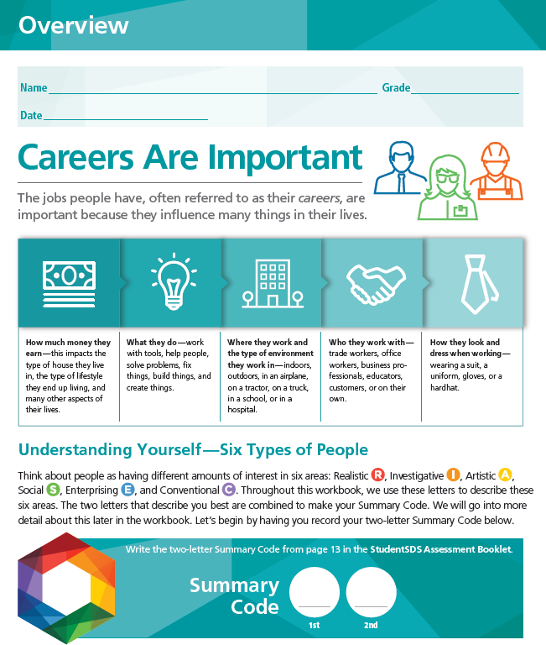
You and Your Future Workbook

Slide 17
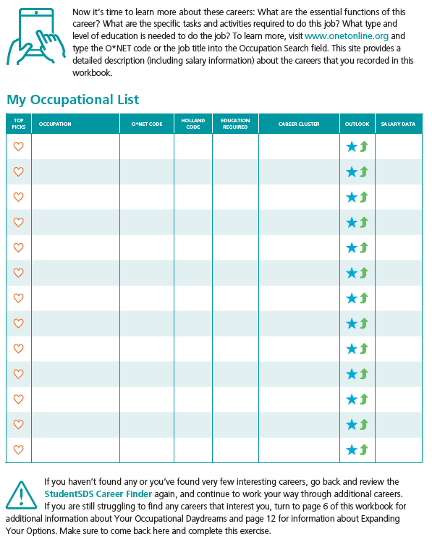
You and Your Future Workbook

Slide 18
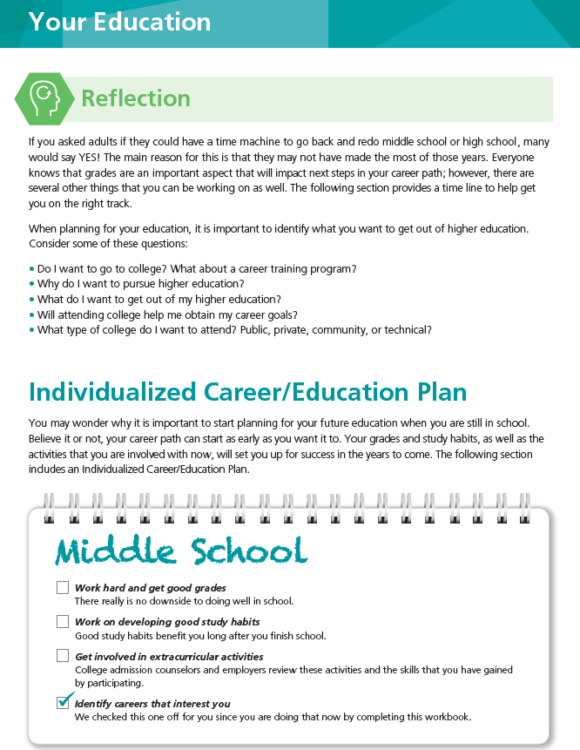
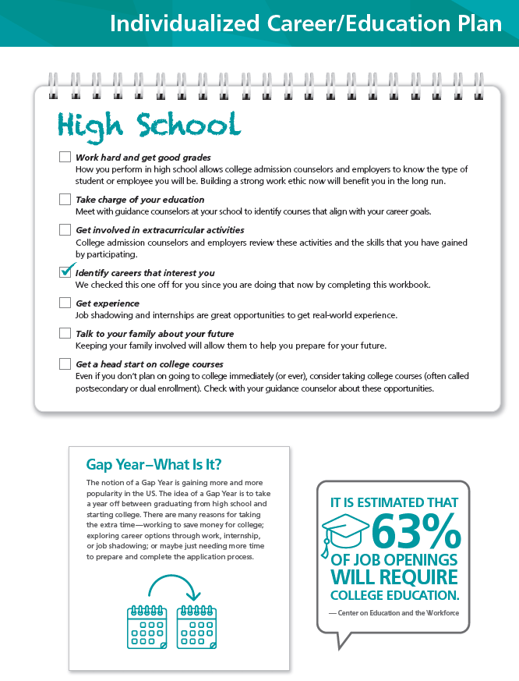
You and Your Future Workbook

Slide 19
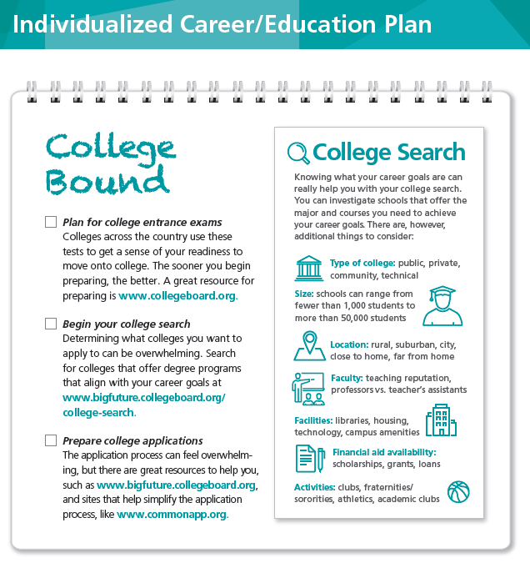
You and Your Future Workbook

Slide 20
Classroom activities
Reproducible worksheets for classroom use
Available in the StudentSDS Professional Manual and Teacher’s Guide
  Long-Term Goal Planning Worksheet
  Educational Options Worksheet
  Career Research Exercise
  Résumé Creation Template
  Sample Job Interview Questions Worksheet

Slide 21
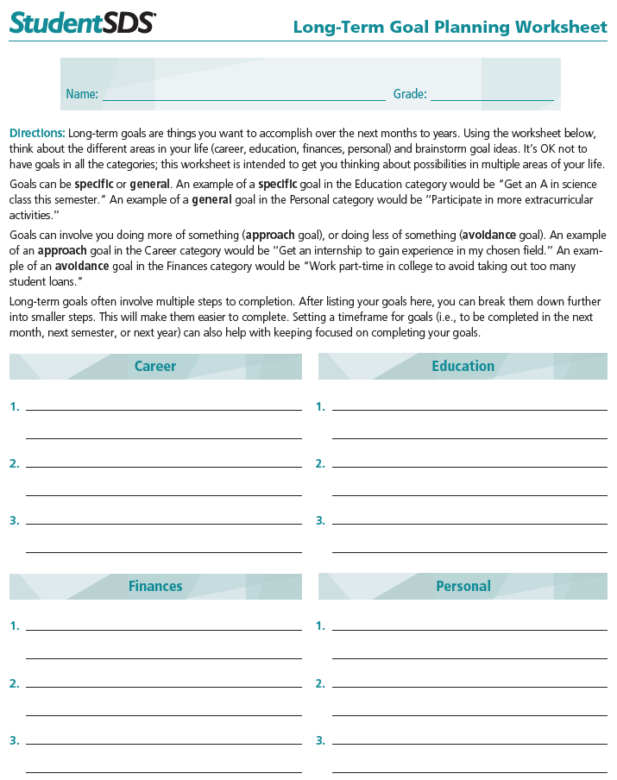

Slide 22
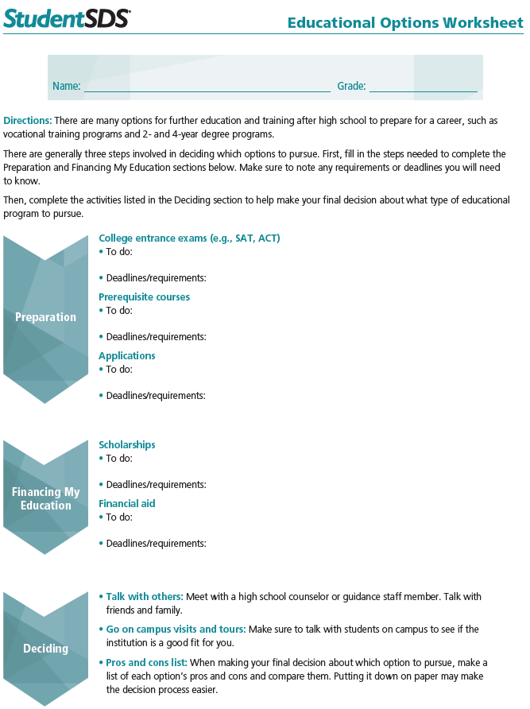

Slide 23
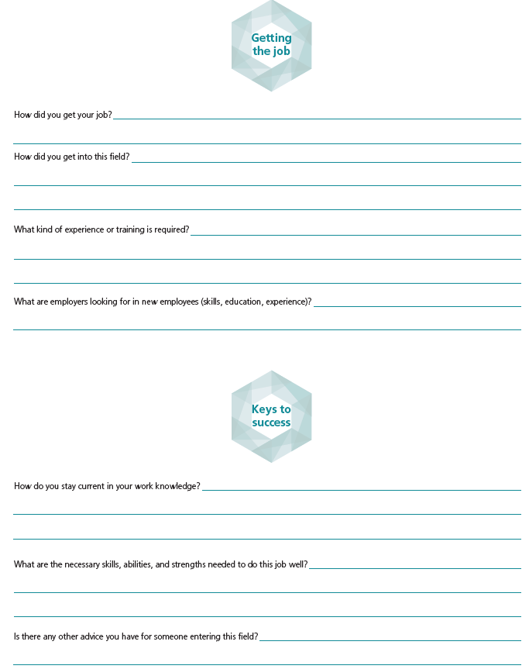
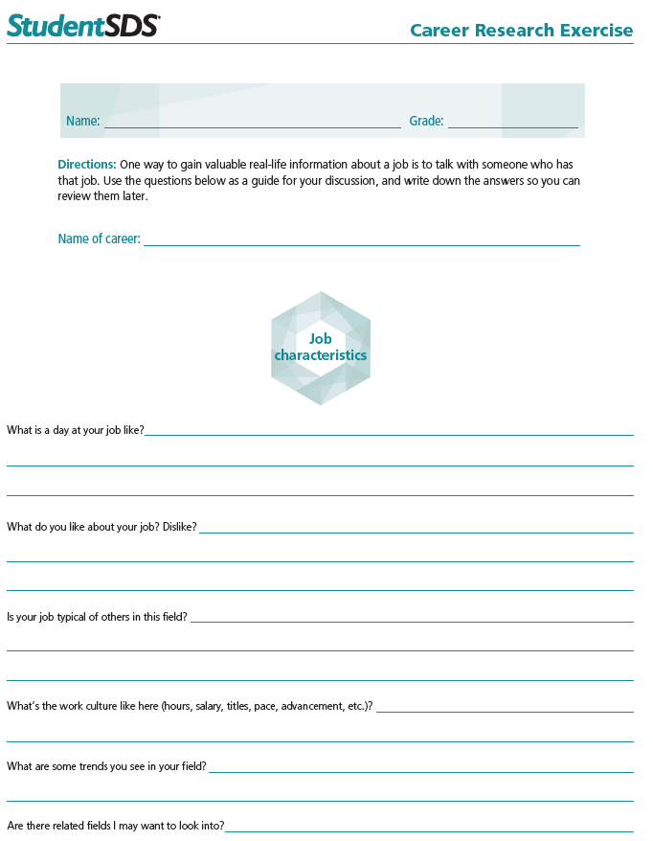

Slide 24
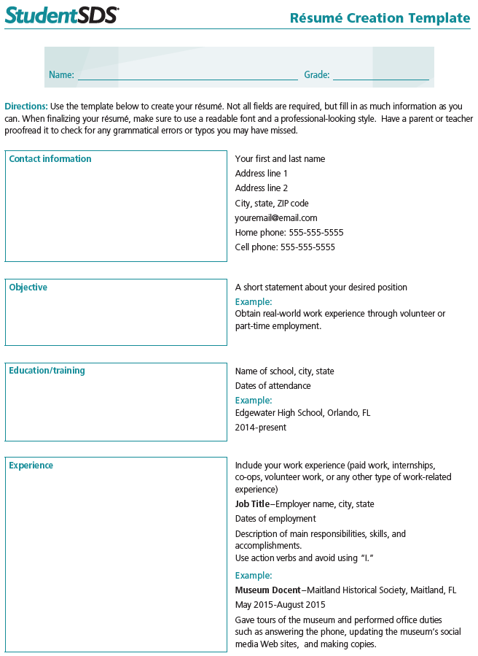
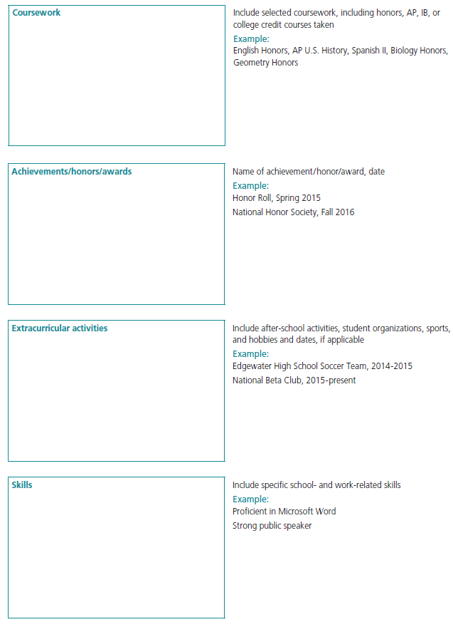

Slide 25
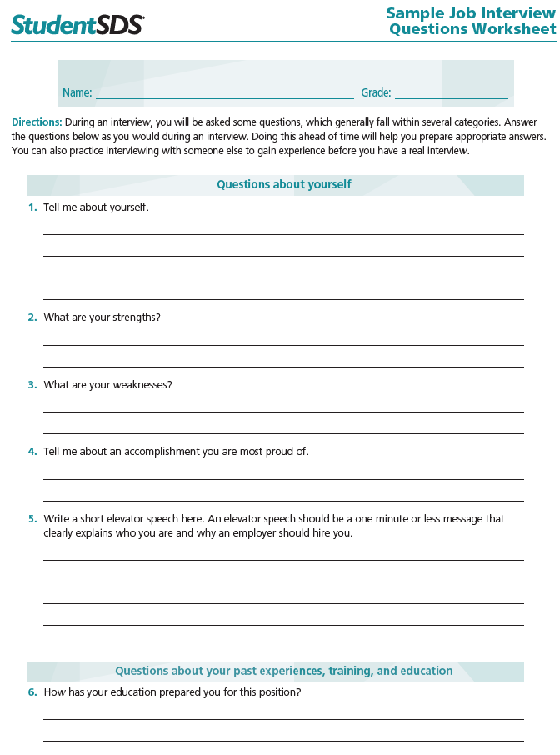
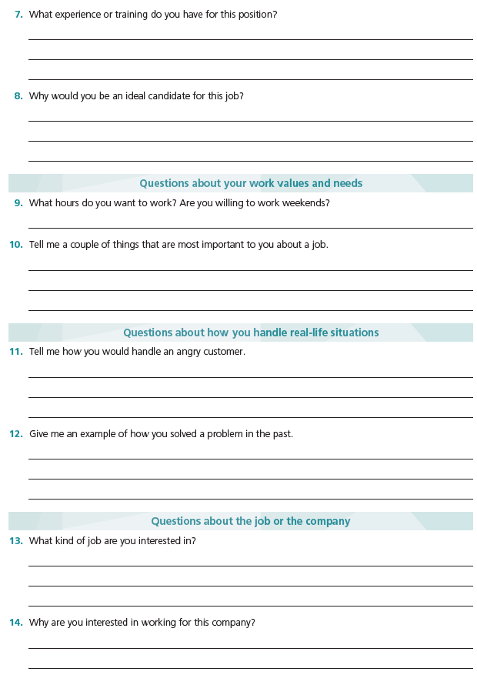

Slide 26
Online Report

Slide 27
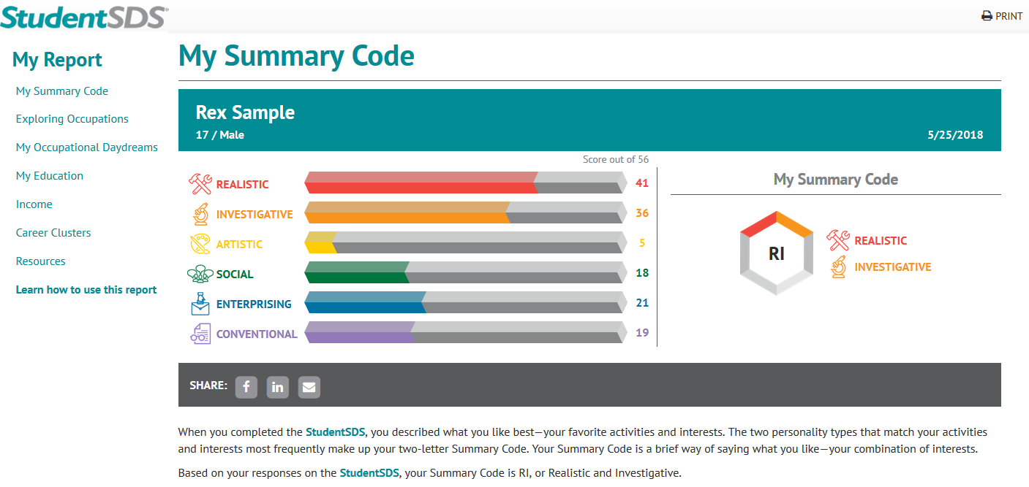
StudentSDS online report

Slide 28
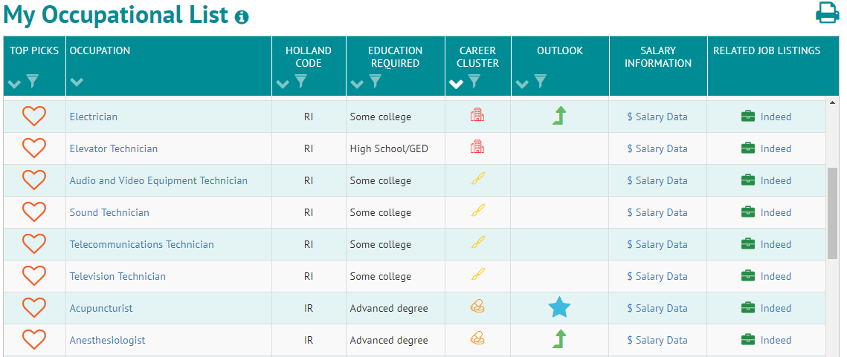


StudentSDS online report
Rapid growth
New and emerging

Slide 29
Case study: Rex

Slide 30
Career exploration areas
Career Exploration
Area 1: Summary Code
Area 3: Programs of Study
Area 2: Occupational Daydreams
Area 4: Career Clusters

Slide 31

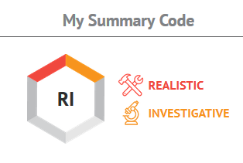

Case Study: Rex
17 years old
High school senior
Exploring majors
Interested in business and engineering fields
Notes:
School counselor recommended SDS so Rex can learn more about his educational and career options.

Slide 32
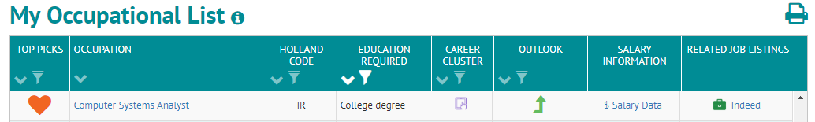
Area 1: Summary code
Explores occupations associated with
RI and IR.
Filters by Education Required to review
occupations requiring a college or
advanced degree.
Identifies Computer Systems Analyst for further exploration.

Slide 33
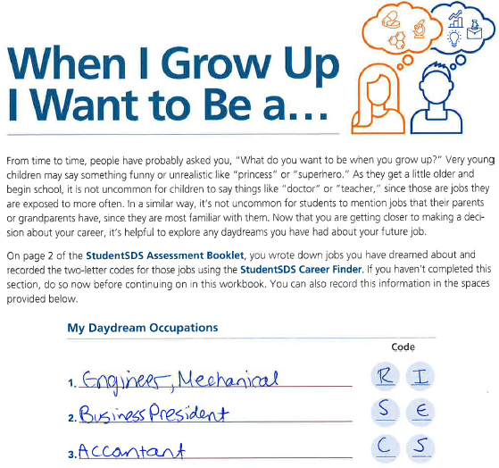
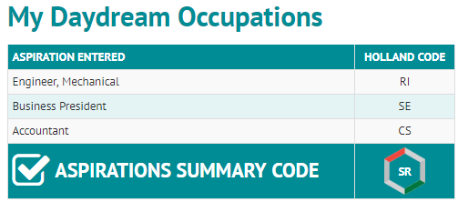
Area 2: Occupational daydreams
Explores occupations by the codes associated with each occupational daydream.
Also searches by the Aspirations Summary Code (average code of all daydream occupations).
Notes:
Occupational daydreams can give insight into the student’s true desires.
Aspirations Summary Code automatically provided in StudentSDS report if three occupations are provided by the student
When examining the Occupational daydreams section, practitioners can examine not only the occupation(s) listed but also the RIASEC code(s) associated with the expressed daydreams.
Practitioners can suggest using the code listed for the first daydream occupation to search for more occupational possibilities with that same code or using the Aspirations Summary Code.

Slide 34
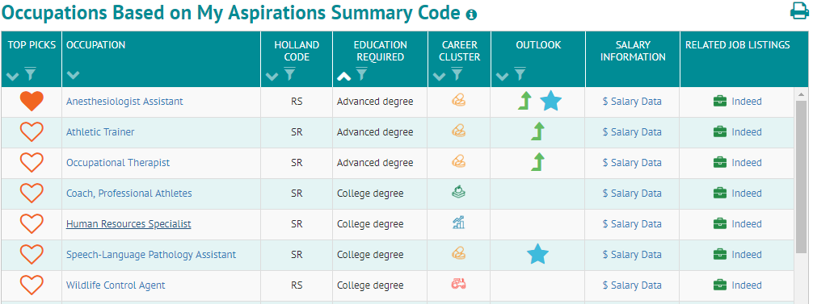
Area 2: Occupational daydreams
After reviewing careers associated with his Aspirations Summary Code, Rex identifies Anesthesiologist Assistant as a potential possibility

Slide 35
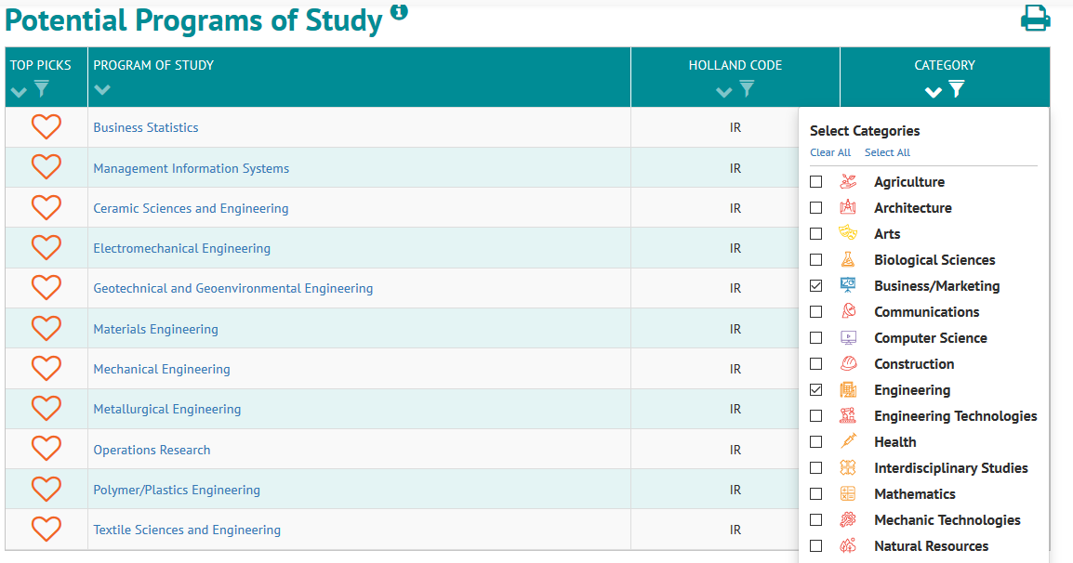
Area 3: Programs of study
The Potential Programs of Study lists programs at 2- and 4-year post-secondary institutions associated with Rex’s code of RI.
Refined his search using the category filters
Notes:
Categories = CIP category (first two digits of CIP code correspond with Category)
The Classification of Instructional Programs (CIP) was originally developed by the U.S. Department of Education's National Center for Education Statistics (NCES) in 1980, with revisions occurring in 1985, 1990, and 2000.

Slide 36
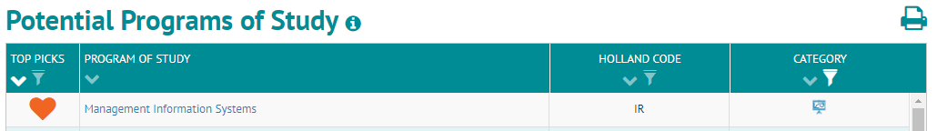
Area 3: Programs of study
Added Management Information Systems to his list of possible majors.
Clicking on each listed program takes Rex to College Navigator so he can learn about colleges and universities that offer programs for these majors.
Notes:
Categories = CIP category (first two digits of CIP code correspond with Category)
The Classification of Instructional Programs (CIP) was originally developed by the U.S. Department of Education's National Center for Education Statistics (NCES) in 1980, with revisions occurring in 1985, 1990, and 2000.

Slide 37
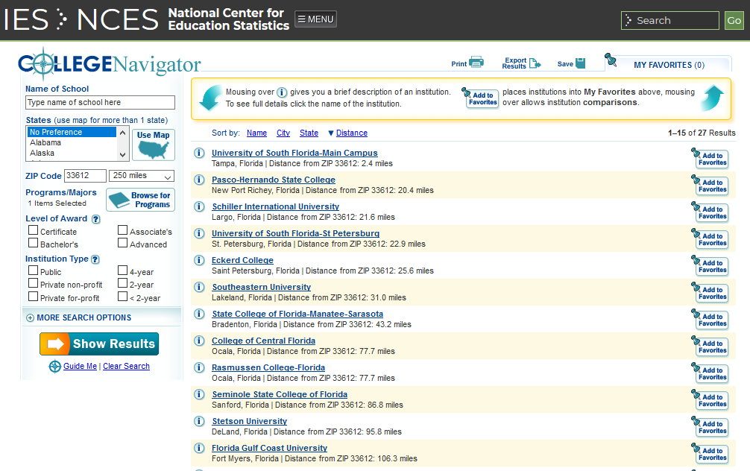
College Navigator
Notes:
Selecting a POS (MIS from his results)→ College Navigator automatically searches within his zip code (based on demographic information). Users can edit the search features.
About our data
College Navigator consists primarily of the latest data from the Integrated Postsecondary Education Data System (IPEDS), the core postsecondary education data collection program for NCES – the National Center for Education Statistics.
Visit the IPEDS website for more information about IPEDS and for access to IPEDS data tools, publications, and more. Follow IPEDS on Twitter for updates and current communications.

Slide 38
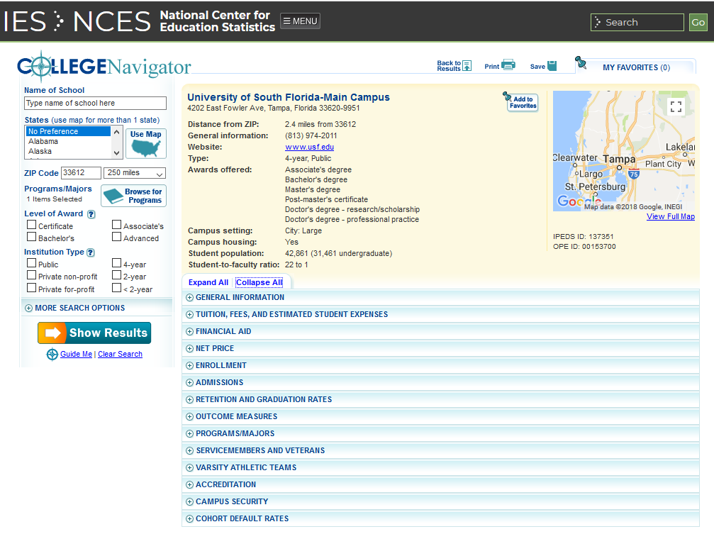
College Navigator
Notes:
When Rex selected a school to explore his options – he is able to see a snapshot overview of information as well as expandable sections to dive deeper

Slide 39
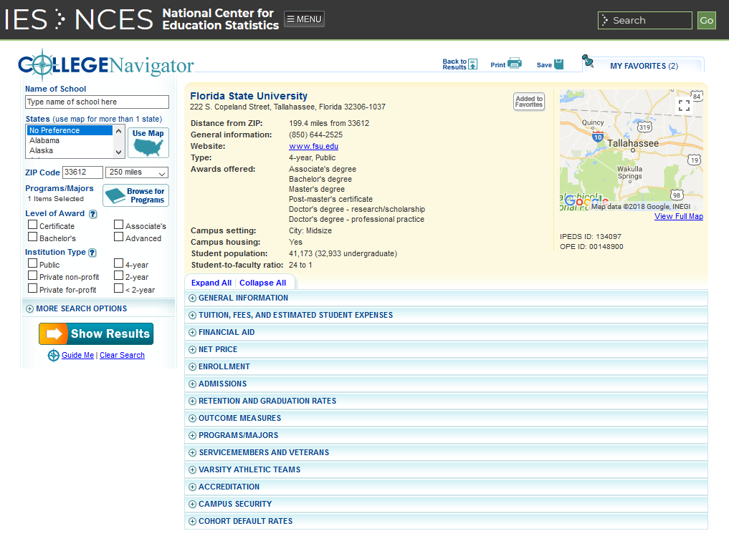
College Navigator
Notes:
College Navigator also allows you to “save” your favorite schools. Rex adds the MIS program at FSU to his favorites

Slide 40
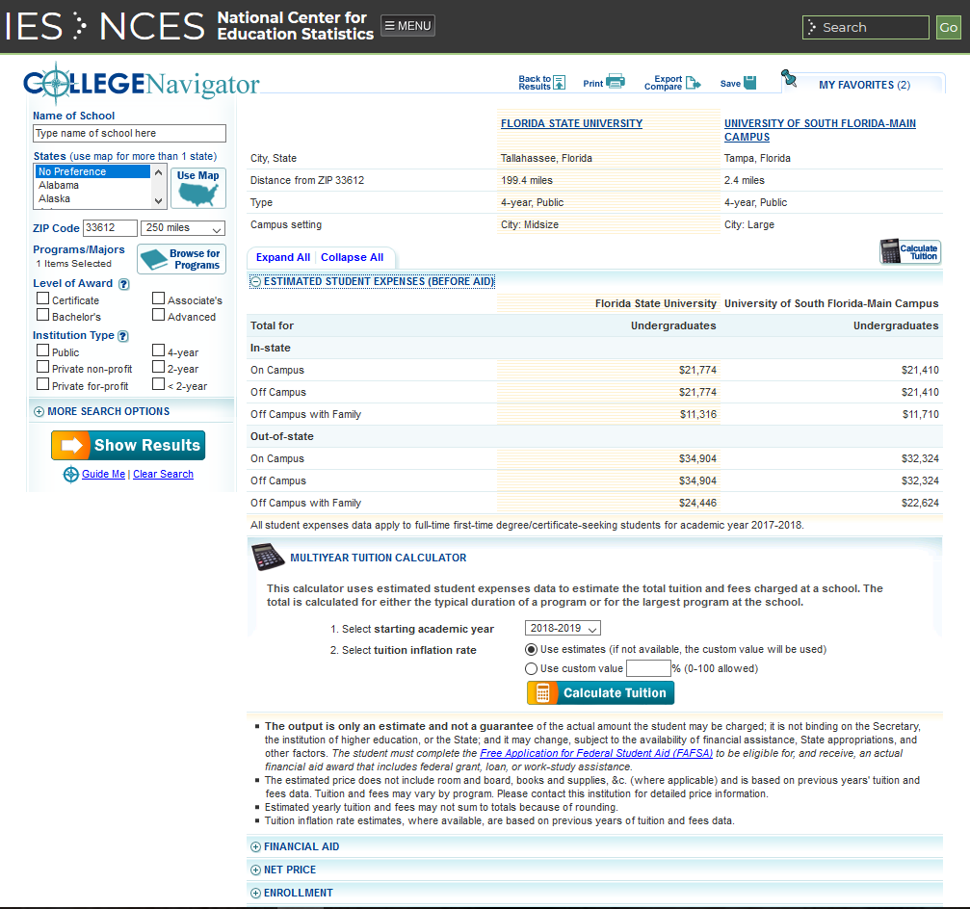
College Navigator
Notes:
MIS program at USF was also added to his favorites – this allows him to now compare the schools side by side.

Slide 41
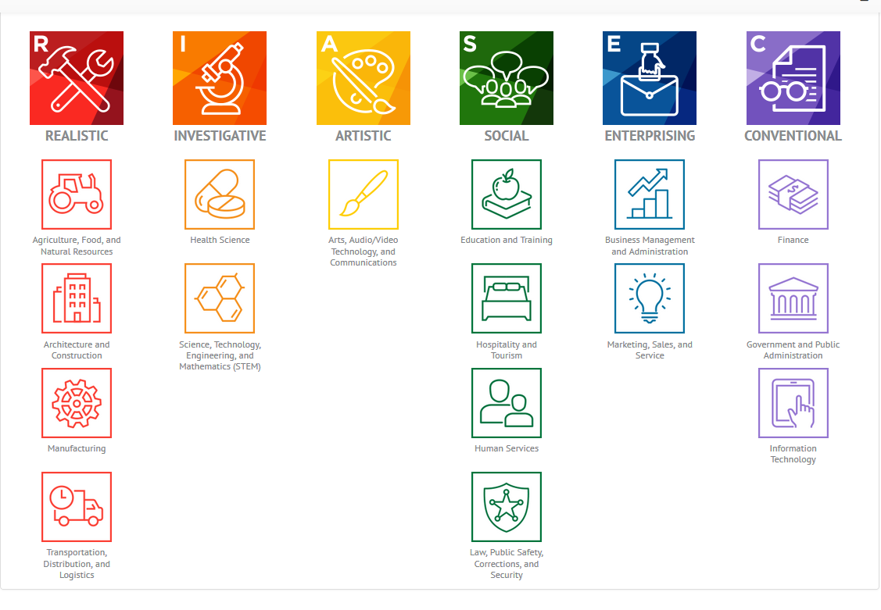
Area 4: Career Clusters
Groups of occupations that are generally in the same field and require similar skills.
Notes:
Rex used the career clusters feature to explore occupations in Science, Technology, Engineering and Mathematics (STEM) and Business Management and Administration

Slide 42
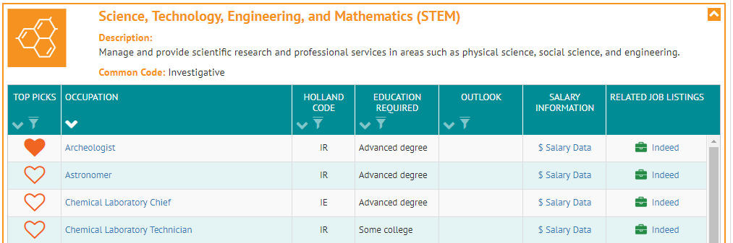
STEM occupations
Rex explores occupations in his interest areas of STEM and Business Management and Administration.
Adds Archeologist to his list of potential occupations.

Slide 43
Career exploration
Career exploration can begin at any point in the list-generation process, depending on the needs of the student.
After generating his list, Rex uses the StudentSDS report to jump-start his career exploration.

Slide 44
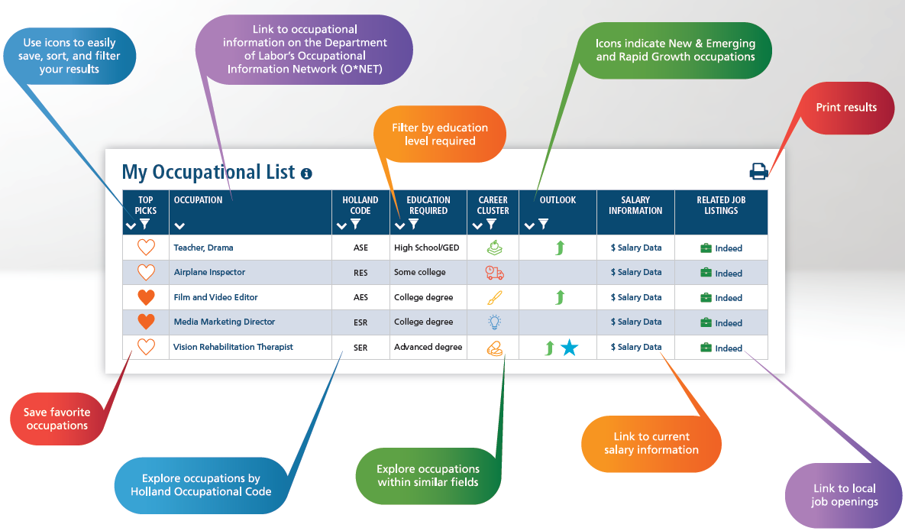
Researching occupations
Notes:
Advantages of online report
Saves time, no flipping through long lists
Filterable and sortable, for example, Rex only wants to see jobs that are college and above
Can use it anywhere

Slide 45
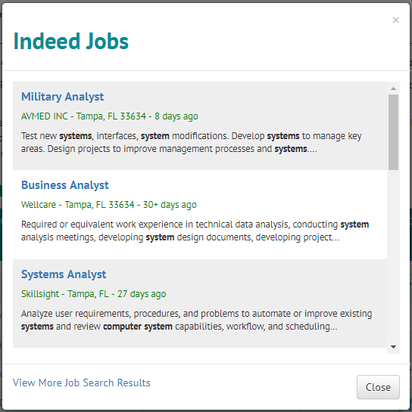
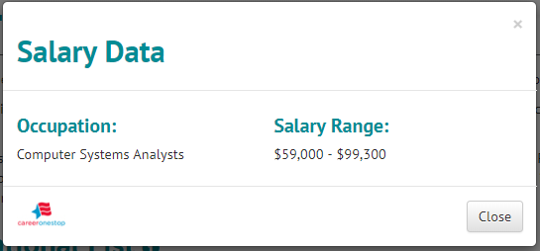
Researching occupations
Notes:
Can easily start applying for jobs

Slide 46
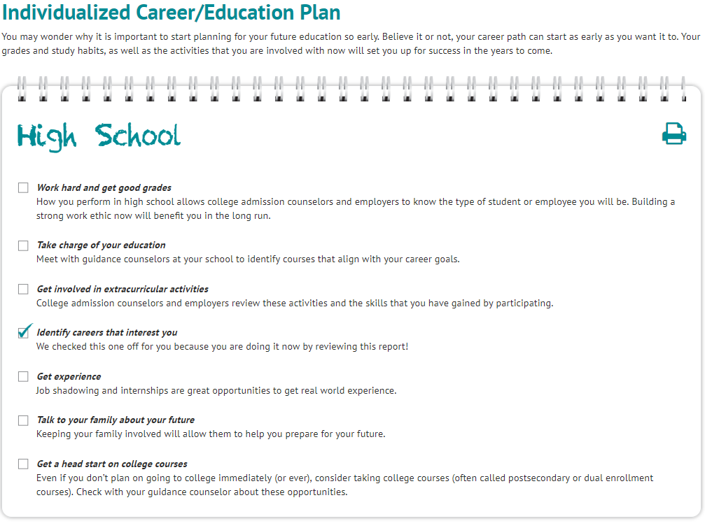
Other features of StudentSDS online report

Slide 47
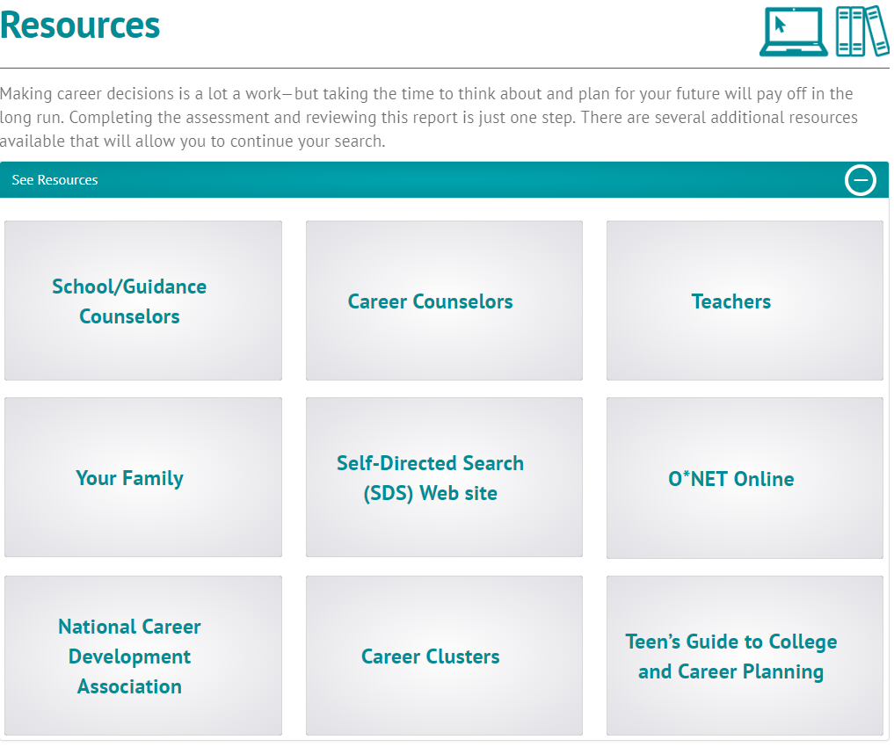
Other features of StudentSDS online report

Slide 48
The
and the NCDG

Slide 49
Personal Social Development
Develop understanding of yourself to build and maintain a positive self-concept.
The StudentSDS helps students identify interests, likes, and dislikes.
Integrate growth and change into your career development.
Provides appropriate resources (including people) to assist in students' career exploration.
Allows students to assess how their interests and preferences (as seen in their Summary Code) are reflected in their career goals (Occupational Daydreams and My Occupational List).

Slide 50
Educational Achievement and Lifelong Learning
Attain educational achievement and performance levels needed to reach
your personal and
career goals.
Reviewing occupations and programs of study helps students recognize the importance of educational achievement on career goals.
Participate in ongoing lifelong learning experiences to enhance your ability to function effectively in a diverse and changing economy.
The StudentSDS may be a student's first time exploring careers via an interactive learning experience.
The Individualized Career/Education Plan provides guidance on planning for their current and future educational needs.
The programs of study list helps students identify learning experiences available to them as well as specific education/training programs.

Slide 51
Career Management
Create and manage a
career plan that meets
your career goals.
Students create a career plan by generating an occupational list and a programs of study list.
Use a process of decision-making as one component
of career development.
The StudentSDS Report and You and Your Career Workbook encourage activities and reflection to enhance decision-making.
Use accurate, current, and unbiased career information during career planning and management.
The StudentSDS Report and materials are regularly updated.
Long-Term Goal Planning Worksheet allows students to identify career goals.

Slide 52
Career Management (continued)
Master academic, occupational, and general employability skills in order
to obtain, create, maintain, and/or advance your employment.
The Résumé Creation Template guides students through the résumé-writing process.
Integrate changing employment trends, societal needs, and economic conditions into your
career plans.
New and Emerging and Rapid Growth icons encourage students to pay attention to employment trends.
The Sample Job Interview Questions Worksheet prepares them for interviews.

