Slide 1
CNNS Family
CNNS
M-WCST
CNNS-SP
CIFA
M-WCST
CIFA

Slide 2
Sample
Johns Hopkins Aging, Brain Imaging, and Cognition (ABC) study
Phase 1: 215 adults Baltimore MD, random calling
Phase 2: 179 adults Baltimore and Hartford, random calling
All participants underwent physical and neurological examinations, psychiatric interviews, laboratory blood tests, brain
MRI scans, and cognitive testing
67 excluded (Parkinsons, TBI, drug abuse, etc.)
Resulting sample of 327

Slide 3
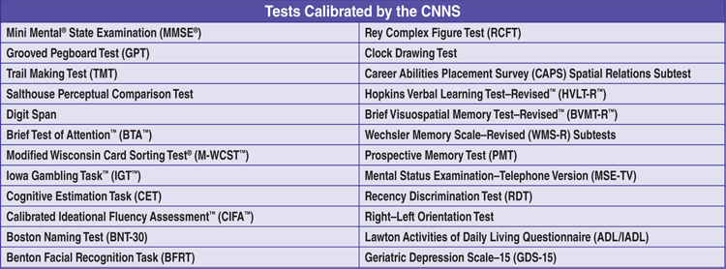
List of CNNS Instruments

Slide 4
Scoring
Paper and Pencil- Manual
Raw score to scaled score (1 to 20), one table for all
Scaled to T scores, calibrated by age: 18 to 25, 26 to 30, etc. to 86+
T to percentile- one table for all
Computer
Raw to scaled
Scaled to T, calibrated based on:
Age
Age, sex, and education
Age, sex, and race
Age, sex, education, and race
Age, sex, education, and HART A/B score
Age, sex, education, race, and HART A/B score
Age, sex, and HART A/B score
Age, sex, race, and HART A/B score
T to percentile
Qualitative label

Slide 5
Scoring (cont’d)
Computer
Factor scores and profile (six scores, uses Standard Scores, %iles, Qualitative label)
Processing speed
Attention/Working memory
Verbal learning and memory
Visual learning and memory
Ideational fluency
Executive functioning
Factor discrepancies
Additional discrepancies

Slide 6
Modified Wisconsin Card Sorting Test (MWCST)
Part of CNNS, used CNNS sample for norming
48 cards
Excludes 80 cards that share more than one attribute with a key card. Therefore won’t score some responses as both correct and perseverative
Administration instructions are easier
Scoring is simpler and faster
Easier to understand and better tolerated by adults diagnosed with cognitive impairments
Still maintains clinical sensitivity to various neurological and psychiatric disorders
Good summary of “why” on pages 2-3

Slide 7
Modified Wisconsin Card Sorting Test (MWCST)
Scaled score norms (1-20)
Scaled to T score conversion by age, education, and sex, and T to percentile conversion
Qualitative labels
Executive Function Composite (also part of CNNS)
Scored with CNNS- SP
Print components:
48 cards
2 sided scoring sheet forms

Slide 8
Calibrated Ideational Fluency Assessment (CIFA)
Part of CNNS, used CNNS sample for norming
Generate verbal or visuoconstruction material as quickly as possible
Require speed as well as self monitoring, working memory and strategy generation
Helpful in diagnosing: schizophrenia, bipolar disorder, Parkinson's disease and TBI
Interrater reliability = .94 and .97
Test retest = .67 to .88
Internal consistency = .73 to .82

Slide 9
Calibrated Ideational Fluency Assessment (CIFA)
Scaled score norms (1-20)
Scaled to T score conversion by age, education, and sex, and T to percentile conversion
Qualitative labels
Ideational Fluency Composite (also part of CNNS)
Discrepancy Scores
Scored with CNNS- SP
Print components:
Record Booklet
Design Fluency task, timed
Verbal Fluency task S,P, Animals, Supermarket, timed

